Slide 1
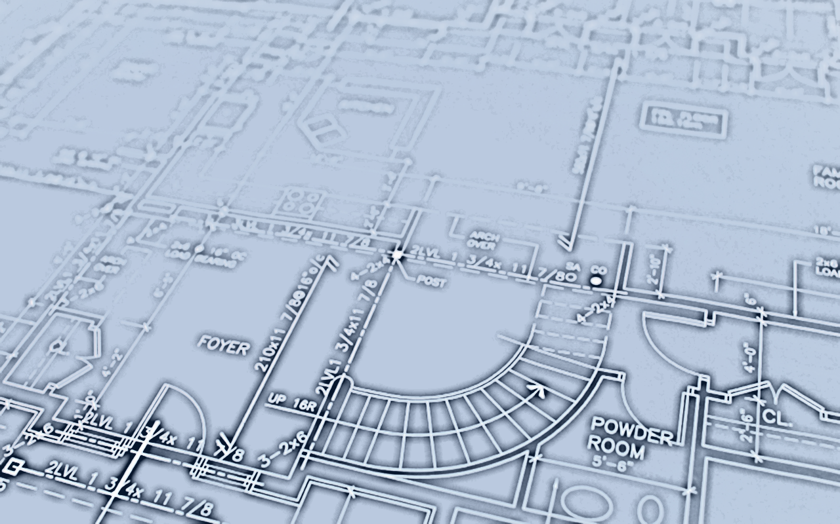
The Formula For ARCHITECTURE
A=(M²+C)xH
a summary of architecture that even engineers can understand
Notes:
Alright, first off I want to say there is no ‘Formula for Architecture’. I just made it up as a joke to Engineers because they love their formulas. They love plugging in numbers and getting exact, perfect answers. It makes them feel all warm and gooey inside. But even if there isn’t a formula, I think we can still use this methodology to learn a lot about how Architectural designs come to fruition.

Slide 2
A=(M²+C)xH
T H E F O R M U L A F O R A R C H I T E C T U R E
Materials
the materials we use for building evolve over time and they affect what kind of structures we can build
Methods
how we build structures evolves over time and this affects what kind of structures are possible
Culture
the form and function of the structure needs to adhere to the lifestyles, traditions, laws, and values of the community
Humanity
the scale and end use of the structure needs to fit the human form
Notes:
So, what do the variables mean? Well… (see slide). The M is squared not just because there are 2 M’s but because the Materials and Methods co-evolve and affect each other. If you discover a new Material that typically leads to a new Method. Likewise, if you come up with a new Method that will most likely spawn a new Material. So they are inextricably linked. Then you add Culture to the mix, and lastly you multiply each one times Humanity because each stage is made by humans for humans. Materials need to be handled by humans, Methods are employed by humans, and Culture is enjoyed by humans.

Slide 3
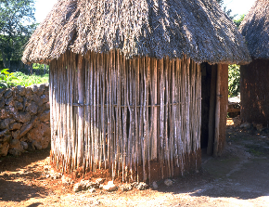
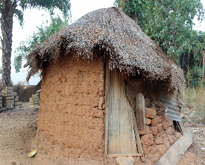
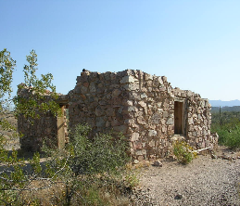
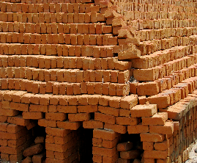
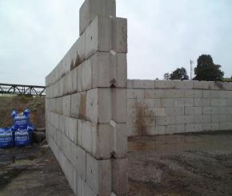
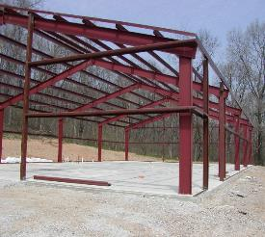
THE FORMULA FOR ARCHITECTURE
Materials
A=(M²+C)xH
the materials we use for building evolve over time and they affect what kind of structures we can build
vegetation/wood
mud/clay
stone
brick
concrete
metal/steel
glass
plastic
Notes:
So what are some examples of Materials? (see slide) Just make note that these are constantly evolving over time and at each stage you can only build structures with the materials that you have on hand.

Slide 4
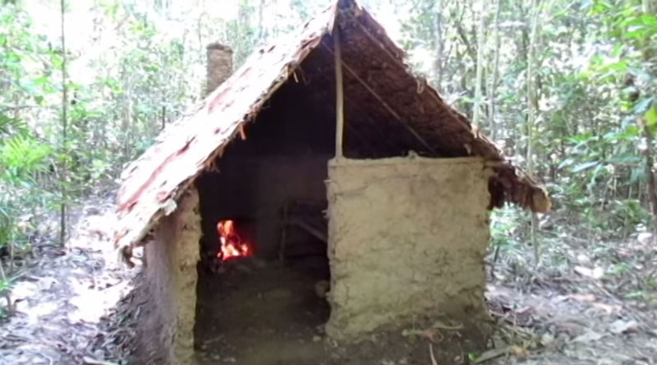
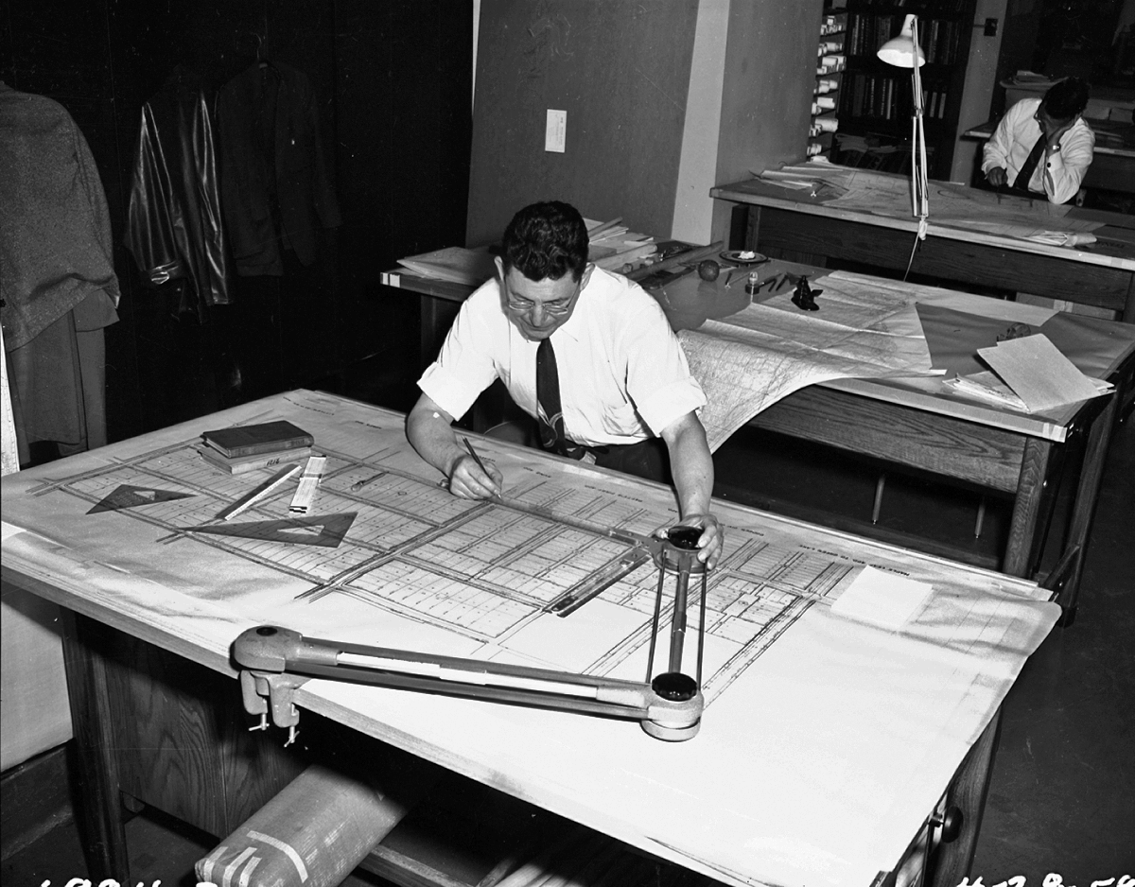
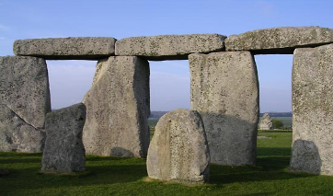
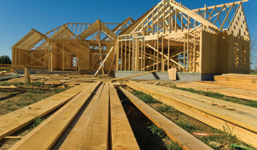
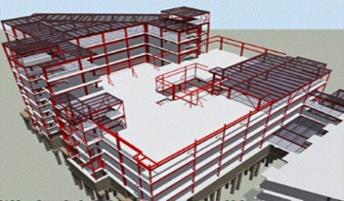
THE FORMULA FOR ARCHITECTURE
Methods
A=(M²+C)xH
how we build structures evolves over time and this affects what kind of structures are possible
fabricating materials
designing the structure
carrying loads
Notes:
The same applies to Methods. New Methods are constantly be tried and refined and a great Architect understands how to use these to make his/her structure come together more efficiently. Some types of Methods include… (see 2 slides) …how we fabricate our material (from using the natural product as is to engineering our material), how we design and document our ideas (from 2D hand drawings to 3D Building Information Modelling), how we support or structures (from beam and lintel construction to cantilevered cable stay load distribution), … (see next slide)

Slide 5
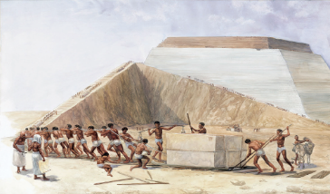
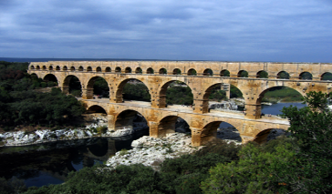
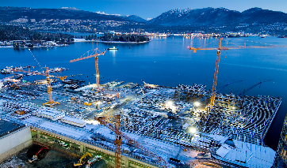
THE FORMULA FOR ARCHITECTURE
Methods
A=(M²+C)xH
how we build structures evolves over time and this affects what kind of structures are possible
constructing the design
funding our projects
sustaining growth
Notes:
…, how we are able to put together our structures (from purely manpower and horsepower to complex machines), how we are able to pay for our projects (from bartering for goods and services to complicated loan modification and refinancing options), and lastly how we accommodate sustainable growth (from imperial expansion to tempered planning and development). All of these methods affect how your project comes together.

Slide 6
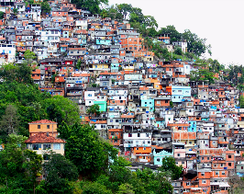
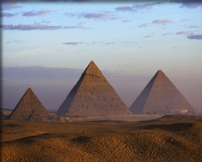
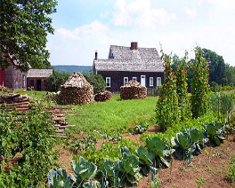
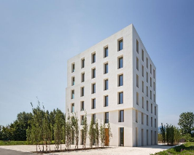
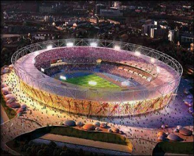
THE FORMULA FOR ARCHITECTURE
Culture
A=(M²+C)xH
the form and function of the structure needs to adhere to the lifestyles, traditions, laws, and values of the community
lifestyle
traditions
laws
values
Notes:
Local culture also needs to be considered for your particular project. Whether is it lifestyle differences (nomadic vs sedentary), traditions (religious or ‘this is the way we’ve always done it’), particular laws (lax or strict), or values (what projects people want to spend their time and money on), you need your project to fit your local culture; otherwise it may get rejected.

Slide 7
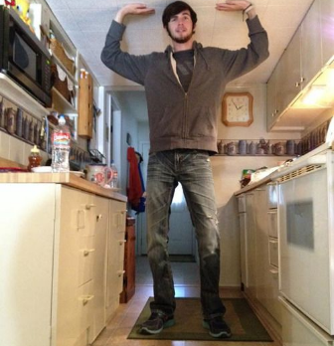
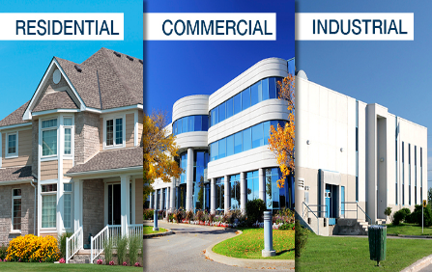
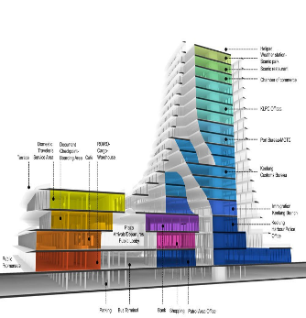
THE FORMULA FOR ARCHITECTURE
Humanity
A=(M²+C)xH
the scale and end use of the structure needs to fit the human form
end use
purpose
function
scale
proportions
size
Notes:
And last but not least is humanity. The first thing you need to consider in this category is scale. If you make spaces too small then your structure can become unusable. You can also use scale to convey an emotion or feeling throughout a space. A small space can feel cozy and intimate, while a grand space can create awe and wonderment. The second thing to consider is end use. What will or can your structure be used for? It can be residential, commercial, industrial; but it can also be educational or used for transportation like a bridge. Also, don’t forget that you can mix functions within a project. Don’t just think about the overall use but consider each individual space of your project and what it could be used for. Some spaces may be used for simple protection from the elements, others may need to be fully integrated with technology that is seamlessly connected to the internet for most efficient functionality.

Slide 8
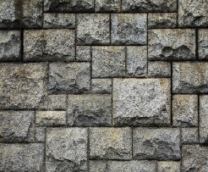
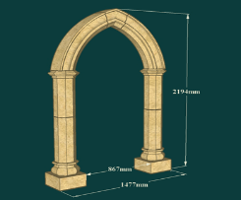
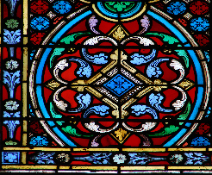
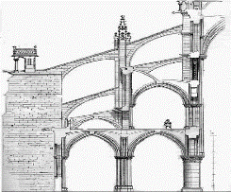
THE FORMULA FOR ARCHITECTURE
Pop Quiz 1
A=(M²+C)xH
Guess the Structure
Materials
Methods
Culture
Humanity
stone masonry
pointed arch
grand scale
Christianity
stained glass
flying buttress
assembly & worship
Notes:
So, let’s take a quiz based on these 4 variables. Who can guess what Architectural structure I am referring to? …(see slide)

Slide 9
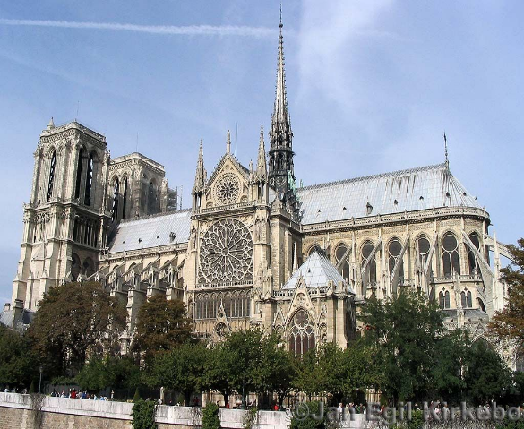
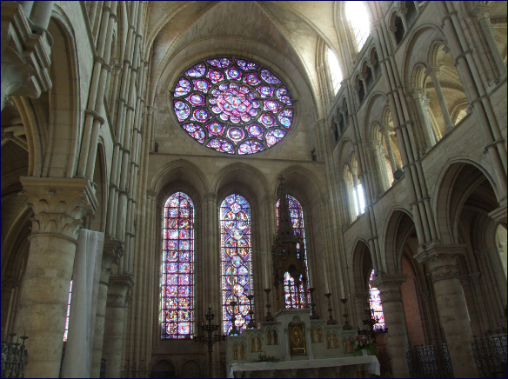
THE FORMULA FOR ARCHITECTURE
Pop Quiz 1
A=(M²+C)xH
www.notredamecathedralparis.com
Notre Dame Cathedral
Montreuil, Lassus, and Chelles

Slide 10
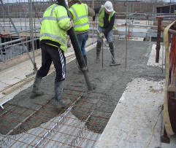
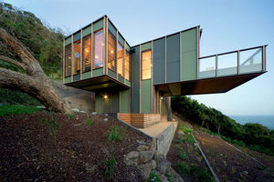
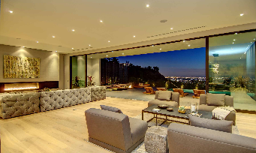
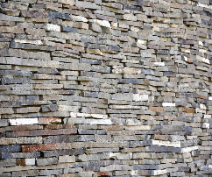
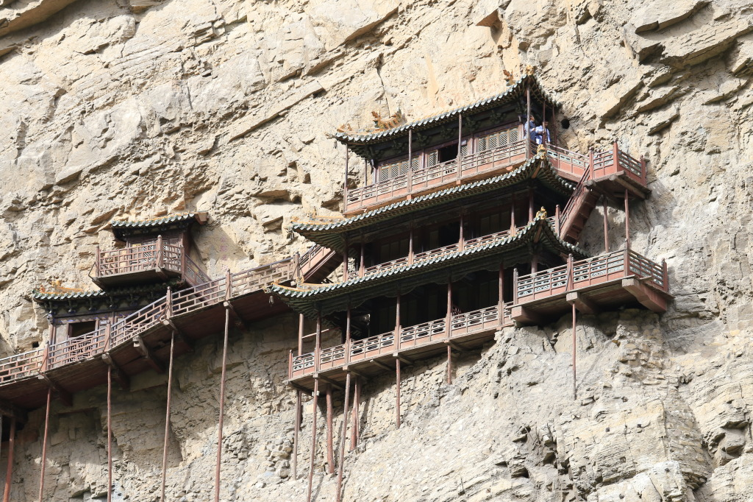
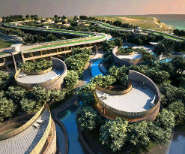
THE FORMULA FOR ARCHITECTURE
Pop Quiz 2
A=(M²+C)xH
Guess the Structure
Materials
Methods
Culture
Humanity
reinforced concrete
cantilever
jet setting
personal luxury
stone masonry
integration
organic/natural
living and entertaining
Notes:
Let’s do something a little harder… (see slide)

Slide 11
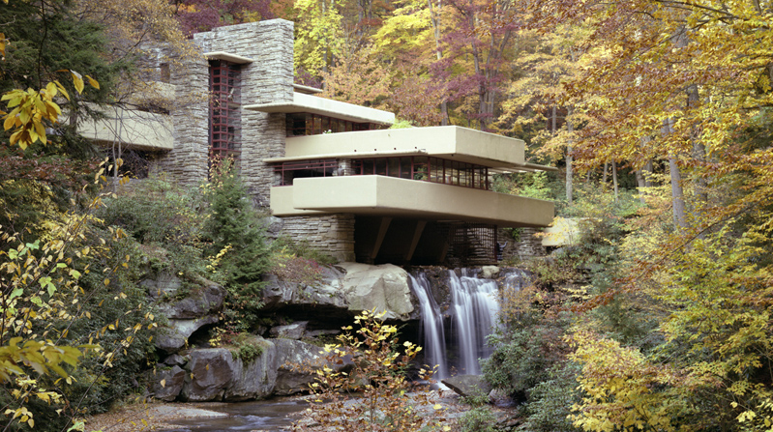
THE FORMULA FOR ARCHITECTURE
Pop Quiz 2
A=(M²+C)xH
www.fallingwater.org
Falling Water
Frank Lloyd Wright

Slide 12
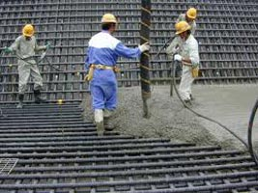
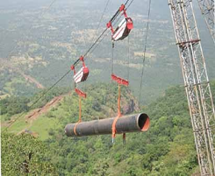
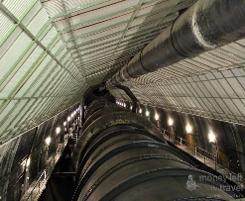
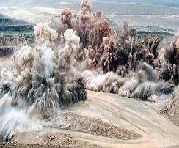
THE FORMULA FOR ARCHITECTURE
Pop Quiz 3
A=(M²+C)xH
Guess the Structure
Materials
Methods
Culture
Humanity
reinforced concrete
cable crane system
economic growth
grand scale
steel piping
dynamite excavation
social welfare
electric power production
Notes:
Alright, one more time. Let’s do something that the engineers at Bechtel can appreciate… (see slide)

Slide 13
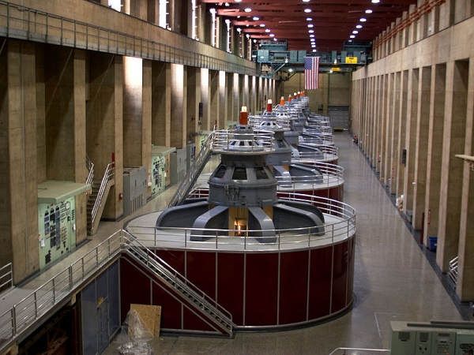
THE FORMULA FOR ARCHITECTURE
Pop Quiz 3
A=(M²+C)xH
www.usbr.gov/lc/hooverdam
Hoover Dam
Kaiser & Kaufmann

Slide 14
A=(M²+C)xH
T H E F O R M U L A F O R A R C H I T E C T U R E
Materials
What new materials are there that you can integrate into your design?
Methods
What new methods of designing, constructing, stabilizing, and sustaining your structure are there?
Culture
What lifestyles, traditions, laws, and values does your project’s community have, and how can you incorporate them?
Humanity
What is the ultimate purpose and scale of your structure? What new functions can you add to your typical project?
Notes:
So as you can see, you can combine these 4 variables in any combination to arrive at any architectural project ever completed or imagined. So, what does this mean for your project? Well, in regards to each one of these aspects of your design you need to ask yourself the following… (see slide) …After asking these questions you need to do your research in each of these areas so that you can come up with a project that not only fits with the culture and humanity of your structure’s community but also pushes the limits of what is possible in regards to the materials and methods you employ.
Materials: materials from waste products, interactive and internet connected materials
Methods: 3D printed structures, a bridge that generates electricity from the ocean tides.
Culture: Transgendered Restrooms may lead to more individual spaces.
Humanity: A bridge doesn’t have to be just for transversing but it can also be a destination with sight seeing and retail space.

Slide 15
The Formula For ARCHITECTURE
A=(M²+C)xH
a summary of architecture that everyone can understand
Notes:
I hope this helps you better understand what goes through an Architects mind as he/she develops their ideas. Let me know if you have any questions or concerns.

